Slide 1
Supporting Healthy Living for
People with Chronic Disease:
A Health Neighborhood Perspective
Laura Saddler, MPH, MCHES, RYT
Health Systems & Self-Management Lead
Oregon Public Health Association
October 10, 2011
Notes:
Thank you
Introduce self, Kelly and Carol
We will be giving you an overview on a project in process to create specific types of connections between Living Well programs and community health centers.

Slide 2
The Health(y) Neighborhood
Environmental Supports
Environmental Supports
Policies
Policies
Systems
Notes:
This is what my section of the Oregon Health Authority – Health Promotion and Chronic Disease Prevention -- eventually envisions our communities to look like
Mechanisms for getting there in a sustainable way are:
Policies (smokefree workplaces, public spaces) and environmental supports (active transportation, access to fresh fruits and vegetables) help make healthy options available to improve health for all
Systems connect people to needed health-related services in the community

Slide 3
Prevalence of Selected Chronic Conditions Among Economically Disadvantaged Oregonians, Medicaid, and Oregonians, 2005
Prevalence | % of General Population | % of Economically Disadvantaged Oregonians | % of Medicaid Recipients
Arthritis | 26% | 30%** | 39%**
Asthma | 10% | 14%** | 19%**
Heart Attack | 4% | 7%** | 7%**
Heart Disease | 4% | 5%** | 8%**
Stroke | 3% | 6%** | 8%**
Diabetes | 6% | 11%** | 13%**
High Blood Pressure | 23% | 28%** | 34%**
High Blood Cholesterol | 32% | 34% | 37%**
** Statistically significant difference, compared to Oregon General Population
Source: Keeping Oregonians Healthy, July 2007.
Notes:
Unfortunately our communities aren’t there yet. Major health disparities still exist.
This table shows how people with lower income and education in Oregon are experiencing significantly higher burden of chronic disease than the general population.
People were considered Economically Disadvantaged if 1) they had a household income <100% of Federal Poverty or 2) they had not completed high school

Slide 4
Background: Health Disparities
Oregon Adult Current Asthma by Annual Household Income, 2007
Source: Behavioral Risk Factor Surveillance System (BRFSS).
Notes:
Despite our best efforts we see widening income-related disparities over time.
This project emphasizes asthma because of the funding source, but we see similar disparities for many other conditions

Slide 5
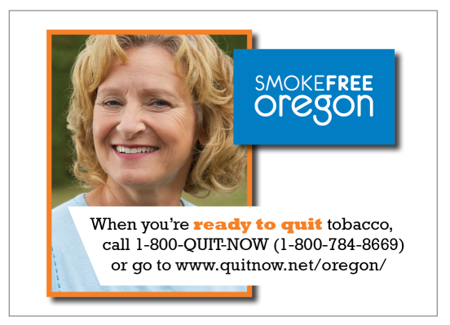
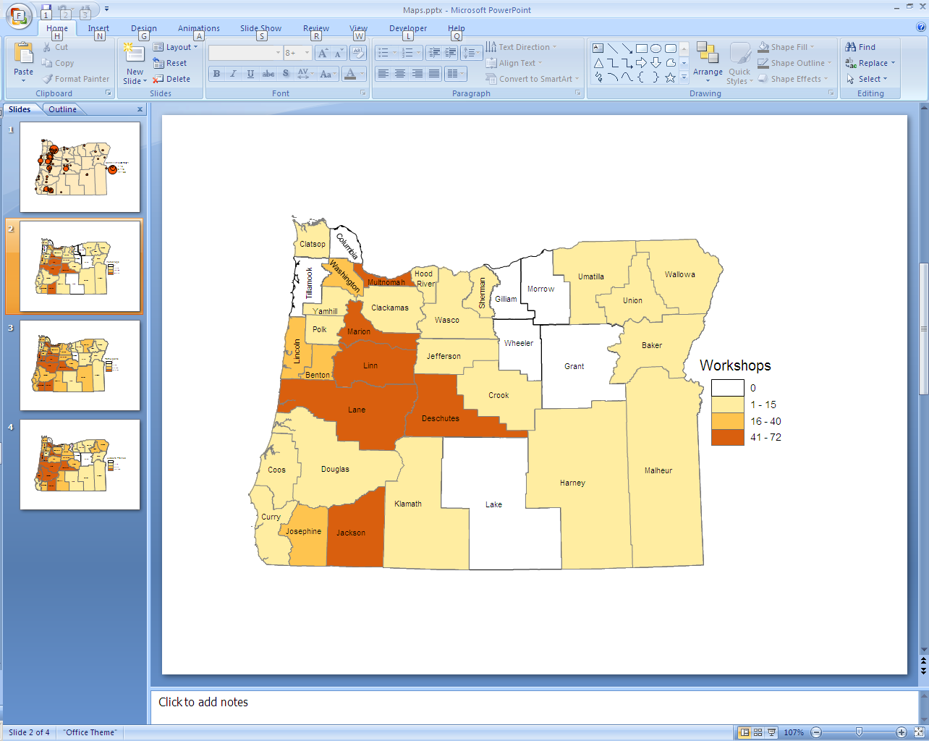
Background: Community Perspective
Self-management and cessation resources are widely available
Programs need participants
Many community programs are challenged to connect with health care systems for referrals
Living Well Programs
by County, 2005-2010
Notes:
Living Well is in 27, Tomando in 8 Counties, Oregon Tobacco Quit Line accessible to anyone with a phone
Programs need participants, and although health care delivery systems seem like a natural place to find them it’s often hard to get connected with the people who can get that flow of information and referrals started
this opportunity brings together partners to engage low populations in need of support that may not be currently accessing programs

Slide 6

Background: Clinic Perspective
Community Health Centers (FQHCs) see a large proportion of low-income and un-/underinsured patients
  Lots of patients with multiple conditions, many stressors
  Statewide: 45% uninsured, 35% Medicaid, 7% Medicare
Clinical visits are rushed, and often focus
on acute, rather than chronic conditions
  Referrals often won’t happen
  without automatic systems in place
  Limited resources to deliver health
  education programs (often not a billable service)
Notes:
People with chronic conditions are often the most challenging & time-consuming patients to medically manage
These patients also tend to be most frequent users of expensive (yet avoidaservices like hospitalizations and emergency room visits
There’s not enough time in a traditional clinical visit to address self-management and get to long-term solutions

Slide 7

Patient Self Management Collaborative
Roles
  Manage & coordinate: Oregon Primary Care Association
  Provide funding, guidance and resources: OHA / Public Health Division
Objectives
  Enhance in-clinic support for self-management
  Develop or refine referral systems to community self-management supports from Community Health Centers
  Identify what works, spread throughout clinics and to different patient populations, replicate throughout state
Notes:
Project emphasizes sustainable systems built into structure of how the clinic does business
Handout describes in detail, especially connections to the Primary Care Medical Home model

Slide 8

How It Works
Collaborative learning model
  Each clinic chooses a multidisciplinary team that includes a community self-management partner
  Practical, interactive approach
  Emphasis on peer learning
Clinic teams attend monthly learning sessions
  In–person kickoff meeting
  Motivational Interviewing training
  Monthly webinars
    Self-management resources and support skills
    Clinical process improvement
Notes:
Carol/Bruce:

Slide 9
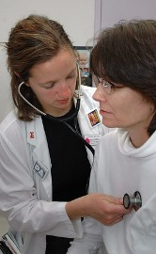
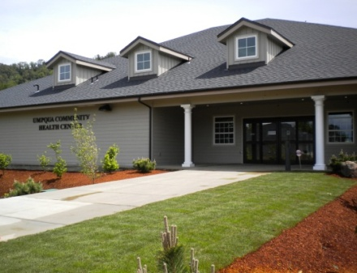
Patient Self Management Collaborative Participating Clinics
Cohort #1 - began September 2010:
NW Human Services - Salem
Community Health Centers of Benton and Linn Counties
- Corvallis
Umpqua Community Health Center - Myrtle Creek
La Clinica del Valle - Central Point/Medford
Siskiyou CHC - Cave Junction
Cohort #2 begins fall 2011:
            Multnomah County Clinic - 9 sites
            Yakima Valley Farm Workers Clinic - Woodburn
            & Salem
            Lincoln County Health Services – Newport
            OHSU Richmond Clinic – SE Portland
Notes:
Cohort 1 clinic systems collectively saw > 41,000 patients in 2010

Slide 10

Laura Saddler, MPH, MCHES, RYT
Health Systems & Self-Management Lead
Health Promotion & Chronic Disease Prevention
Oregon Public Health Division
(971) 673-0987
laura.c.saddler@state.or.us
www.healthoregon.org/livingwell
www.healthoregon.org/takecontrol

Slide 11


Patient Self-Management Collaborative: From the Clinic Perspective
Community Health Centers of Benton and Linn Counties
(Corvallis)
  Four clinic sites: 3 in Benton County and 1 in Linn County
Unique situation:
  Co-located with Benton County Health Department
    Health Navigation
    Peer Wellness Specialists
    Health Promotion
      Chronic Disease Prevention
      Tobacco Prevention
    WIC
    Mental Health
    Immunizations
  Electronic Health Record that all providers use

Slide 12
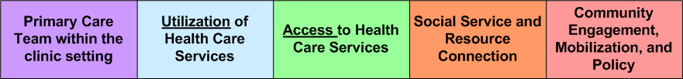
Health Navigators and Peer Specialists
Community Health Workers
  Trusted members of the community they serve
  Shared life experience
  Knows the culture and language of their community – serve as “cultural brokers”
Roles cross spectrum of services, from the clinic to the community
Trained facilitators for Living Well with Chronic Disease and Tomando Control de su Salud

Slide 13
Multi-disciplinary collaboration
OPCA team made up of:
  Health navigators
  Peer specialists
  Health promotion specialists
  Registered Nurse Care Coordinator
  Community ambassador - Carole Kment from Samaritan Services
  Health Systems Improvement Manager
  Health Navigation Manager
  Client Services Manager
Allowed team to build a referral pathway in EHR with input from multiple partners
  Made it easy to “troubleshoot” the process

Slide 14
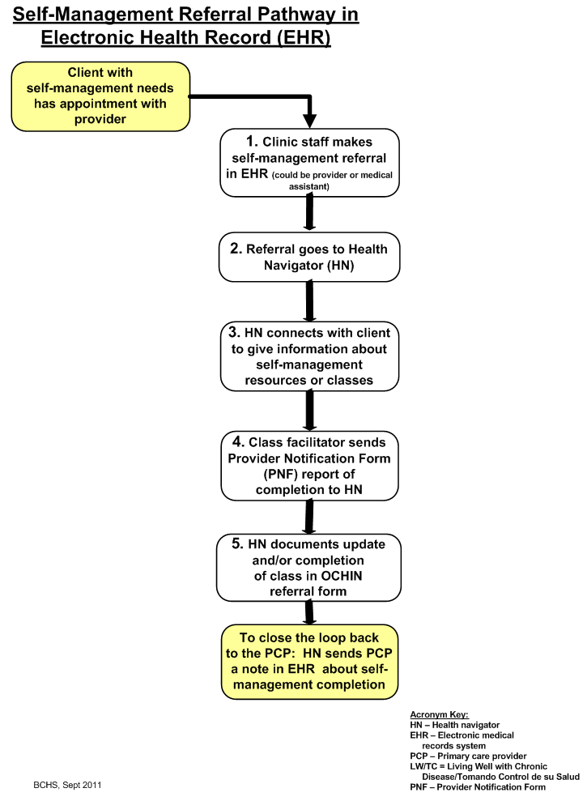
Original pathway
(simple)

Slide 15
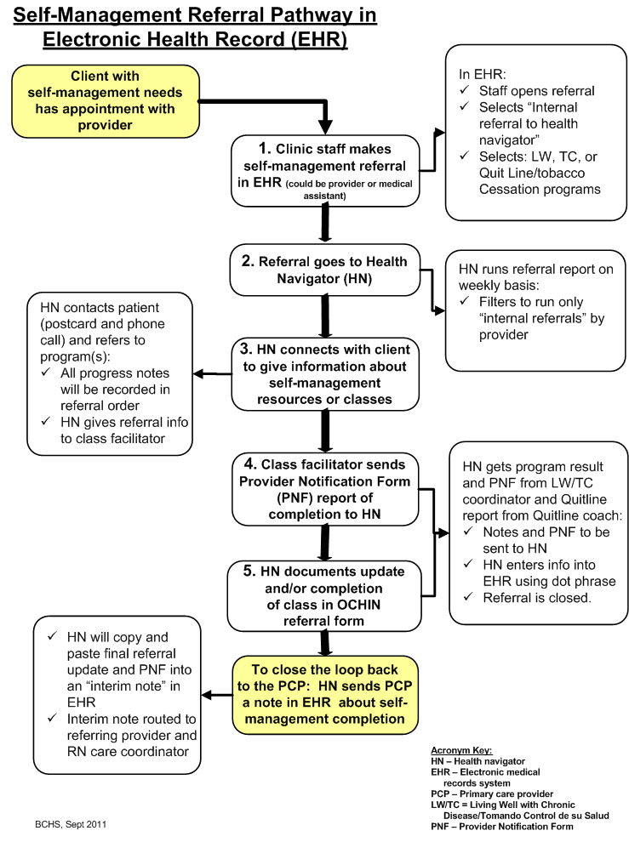
Final
Pathway
(not so
simple)

Slide 16
How is it working?
Took time to get it functioning properly in EHR
Started process with one provider at main clinic site in Corvallis
Have since expanded to E. Linn clinic in Lebanon
Results?
We have had 10 referrals through the EHR pathway to Living Well or Tomando Control since July 25

Slide 17
Challenges?
Keeping forward momentum in the face of competing priorities
  Participation in the collaborative really helped with that!
Lack of funding for Tomando Control classes
  What good is a referral pathway if you have nothing to refer patients to?

Slide 18
Next steps?
Planning to “roll out” process to other clinic sites and all providers
Expanding pathway to WISEWOMAN referrals
  Free risk factor screening program for low-income women
Continued quality improvement

Slide 19

Kelly Volkmann, RN, MPH
Health Navigation Program Manager
Benton County Health Services
(541) 766-6839
Kelly.volkmann@co.benton.or.us

